Slide 1

Module 1
Overview of the Data Mining Process
Notes:
Guidelines
Use section headers to chunk content in your presentation.
Use the same style of section header throughout your presentation.
Keep your title to no more than 2 lines.

Slide 2

Example: Reduce Dimensions
Notes:
Guidelines
Use a title slide at the beginning of your presentation. There are 9 variations of title slides to choose from.
If you will have a series of slideshows, we recommend using the same style of title slide for each presentation.
Keep your title to no more than 2 lines.
Do not change the font style or font size of the title or subtitle.

Slide 3
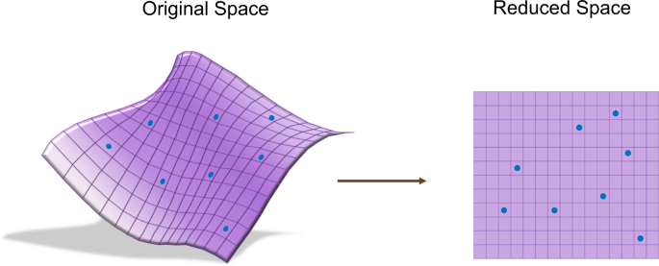
Reducing Dimensions
The main reason for this is to avoid overfitting.
Reducing dimensions helps with computational costs.
The main approach involves projecting from a high to low dimensional space

Slide 4
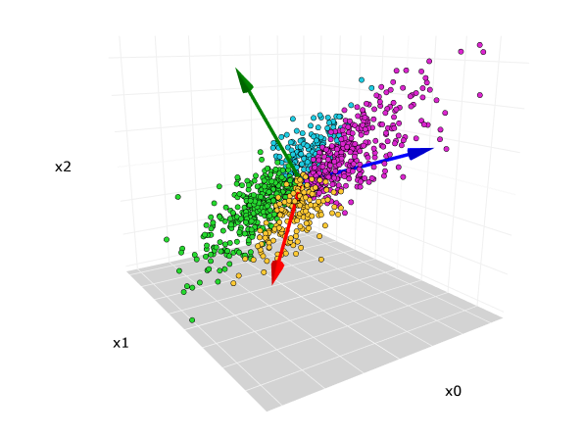
Principal Component Analysis
Based on projecting to low dimensional spaces.
Simplifies the complexity while retaining trends and patterns
Creates new variables (principal components) which are functions of the original variables

Slide 5
Python
Notes:
Guidelines
Use a title slide at the beginning of your presentation. There are 9 variations of title slides to choose from.
If you will have a series of slideshows, we recommend using the same style of title slide for each presentation.
Keep your title to no more than 2 lines.
Do not change the font style or font size of the title or subtitle.

Slide 6
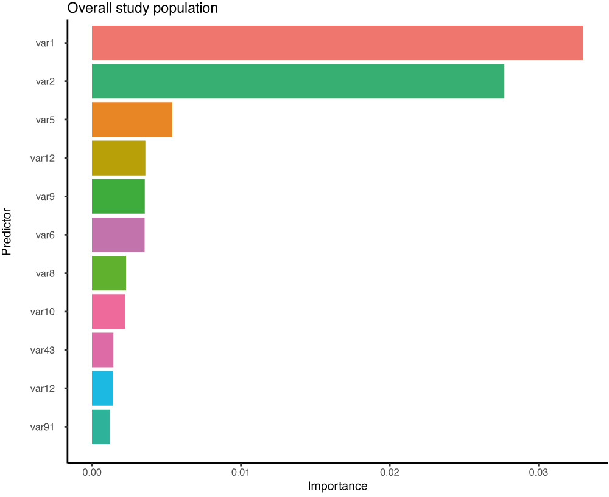
Variable Selection
We can also use automatic variable selection techniques
Ensemble methods are useful in variable selection

Slide 7
Python
Notes:
Guidelines
Use a title slide at the beginning of your presentation. There are 9 variations of title slides to choose from.
If you will have a series of slideshows, we recommend using the same style of title slide for each presentation.
Keep your title to no more than 2 lines.
Do not change the font style or font size of the title or subtitle.

